Slide 1
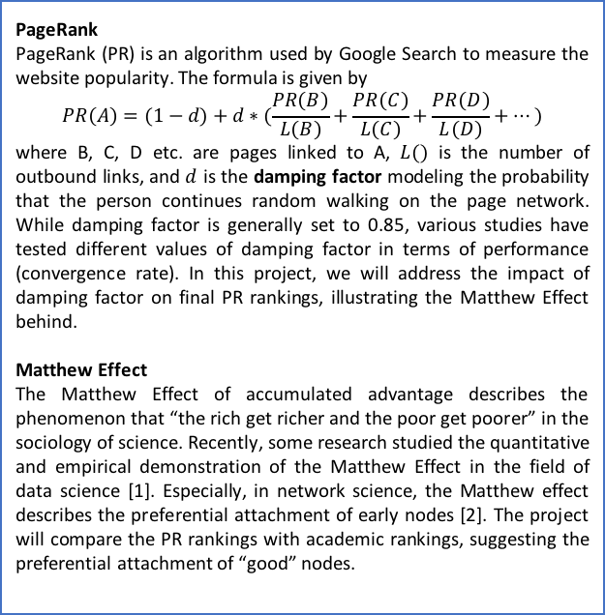
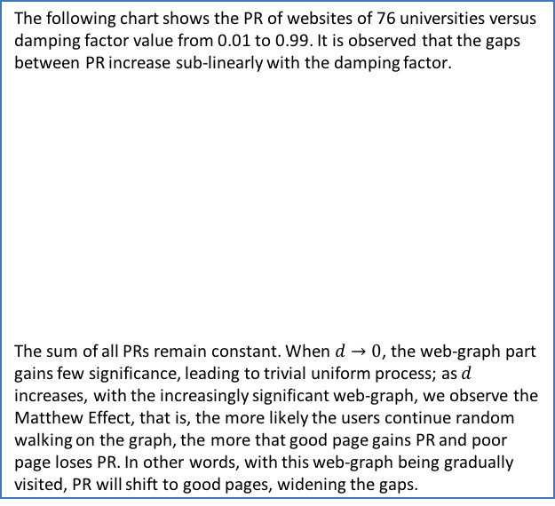
The Matthew Effect: University Academic Ranking and PageRank
WU Aoyu
1. Introduction
3. PageRank and Damping Factor d
5. HITS & Hub rankings
This project aims to explore the PageRank of Chinese (mainland) University Weblink and compare them with academic rankings. Based on Google’s PageRank algorithm and data visualization, the findings reveal the underlying Matthew Effect – the good gain preferential attachment and get better.
The following chart shows the PR of websites of 76 universities versus damping factor value from 0.01 to 0.99. It is observed that the gaps between PR increase sub-linearly with the damping factor.
The sum of all PRs remain constant. When $d→0$, the web-graph part gains few significance, leading to trivial uniform process; as $d$ increases, with the increasingly significant web-graph, we observe the Matthew Effect, that is, the more likely the users continue random walking on the graph, the more that good page gains PR and poor page loses PR. In other words, with this web-graph being gradually visited, PR will shift to good pages, widening the gaps.
HITS and Hub, as alternatives for Weblink popularity measurement, are also examined and compared with PageRank rankings. It is found that PageRank and Authority produce similar results, while ranks by Hub give difference result.
2. Background
PageRank
PageRank (PR) is an algorithm used by Google Search to measure the website popularity. The formula is given by
$$PR\left(A\right)=(1−d)+d∗(\frac{PR\left(B\right)}{L\left(B\right)}+\frac{PR\left(C\right)}{L\left(C\right)}+\frac{PR\left(D\right)}{L\left(D\right)}+…)$$
where B, C, D etc. are pages linked to A, $L()$ is the number of outbound links, and $d$ is the damping factor modeling the probability that the person continues random walking on the page network. While damping factor is generally set to 0.85, various studies have tested different values of damping factor in terms of performance (convergence rate). In this project, we will address the impact of damping factor on final PR rankings, illustrating the Matthew Effect behind.
Matthew Effect
The Matthew Effect of accumulated advantage describes the phenomenon that “the rich get richer and the poor get poorer” in the sociology of science. Recently, some research studied the quantitative and empirical demonstration of the Matthew Effect in the field of data science [1]. Especially, in network science, the Matthew effect describes the preferential attachment of early nodes [2]. The project will compare the PR rankings with academic rankings, suggesting the preferential attachment of “good” nodes.
6. Compare Ranking
The ranks by PageRank, Authority and Hub are compared with university academic rankings by Spearman's rho and Kendall’s tau. The results are as follows:
It is observed that both PageRank and Authority give approximate estimation on academic rankings, suggesting that inbound links matter more than outbound in terms of rankings. Once again we observe the Matthew Effect: the more that one is referred to, the more that the one gain.
 | PageRank | Authority | Hub
Spearman's rho | 0.6994 | 0.7202 | 0.4335
Kendall’s tau | 0.5041 | 0.5454 | 0.3060
4. PageRank and Outbound/Inbound Links
As shown in the right chart, the number of inbound links predominately influences the PR; while the number of outbound links show limited impact.
7. Reference
[1] M. Perc, The Matthew effect in empirical data, J R Soc Interface, 2014.
[2] Barabási, A-L; Albert, R (1999). "Emergence of scaling in random networks". Science. 286: 509–512.

